Slide 1

Data Transmission

Slide 2
Topics to be covered
Types and methods of data transmission:
Data Packets
Data Transmission
Universal Serial Bus (USB)
Methods of error detection:
The need to check for errors
Parity checks, checksum, echo check
Check Digits
Automatic Repeat Requests (ARQs)
Symmetric and Asymmetric Encryption

Slide 3
Why is there a need for data transmission?
Data is frequently transferred from one device to another. The two devices could be in the same building or thousands of kilometres away.
The following should be kept in mind while transmitting data:
how the data is transmitted
how can errors following transmission be detected and can the data be recovered
the role of encryption to make sure data that falls into the wrong hands can’t be used

Slide 4
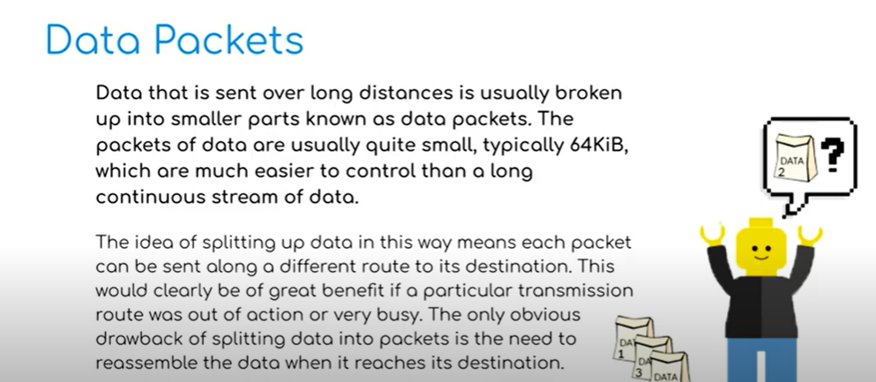
Source : https://www.youtube.com/watch?v=iZcvAI8puu0

Slide 5
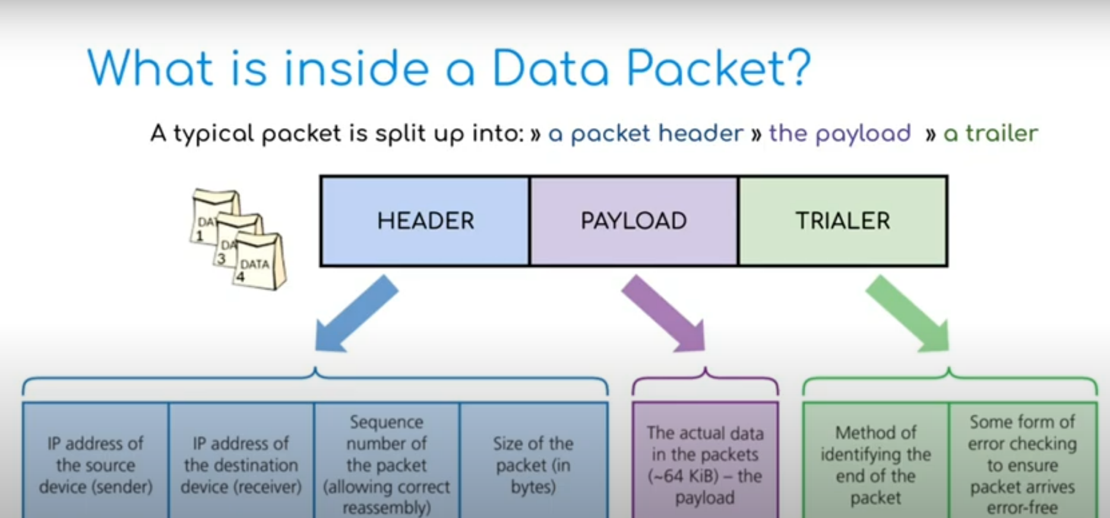

Slide 6
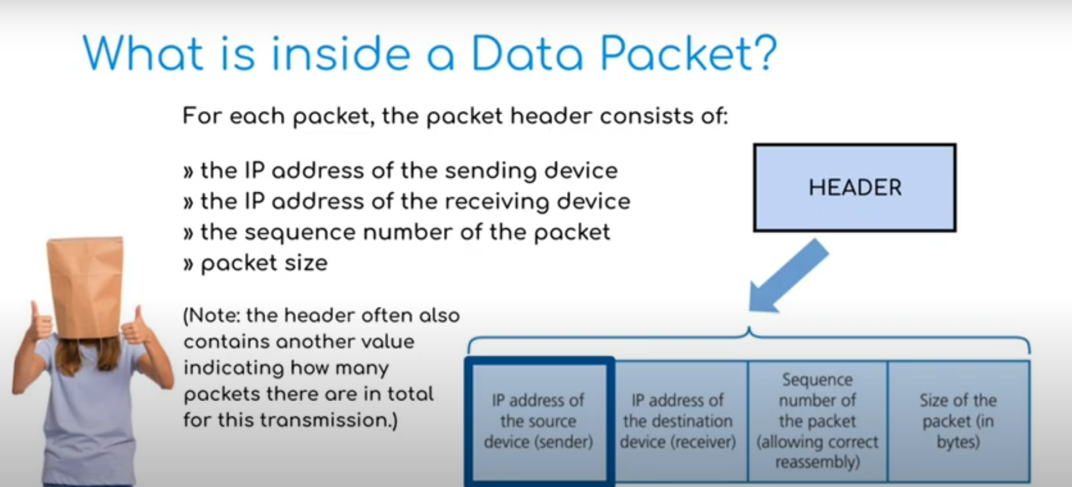

Slide 7
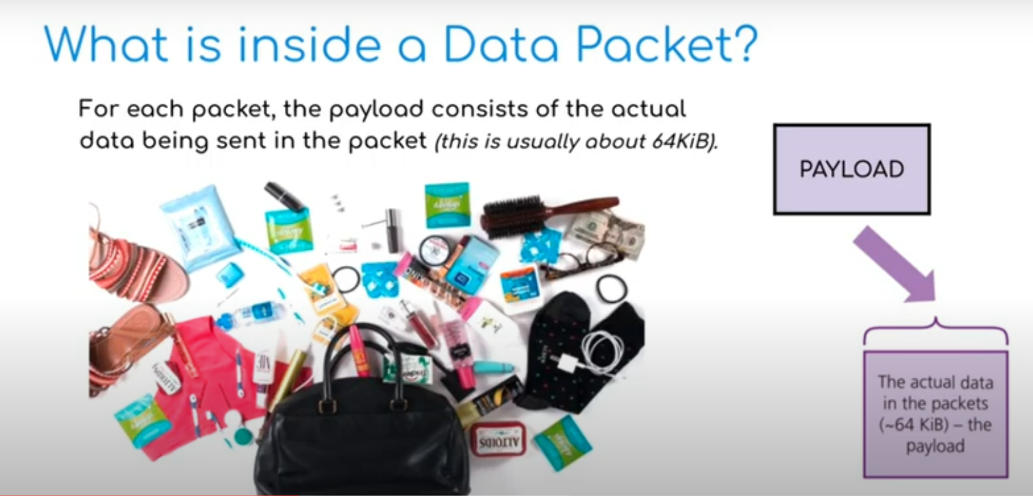

Slide 8
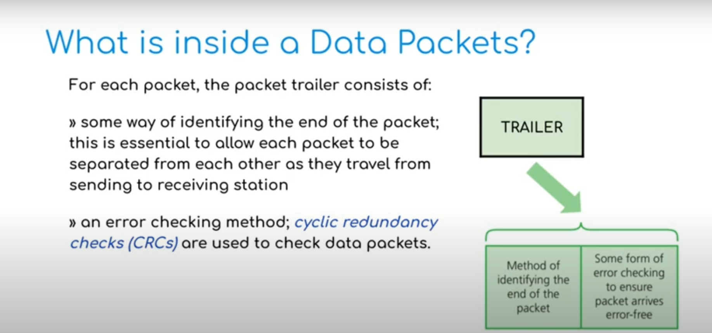

Slide 9
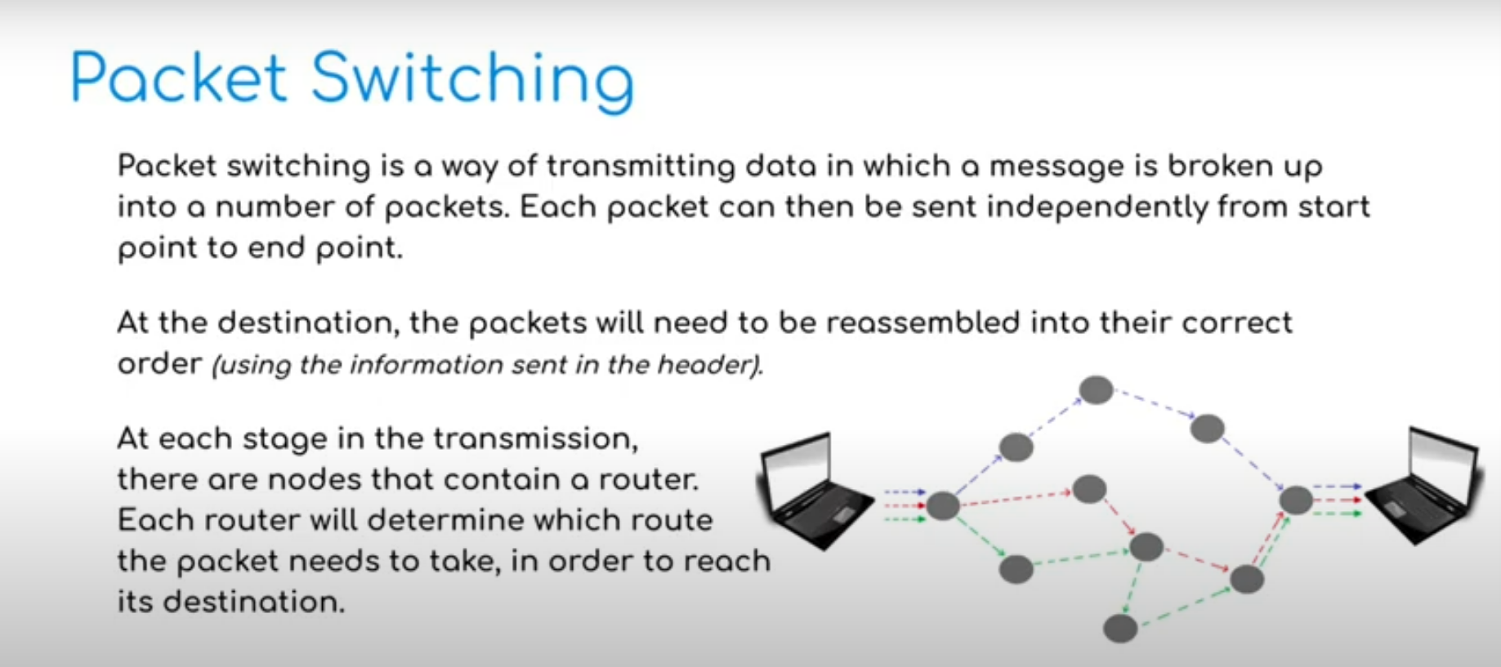

Slide 10
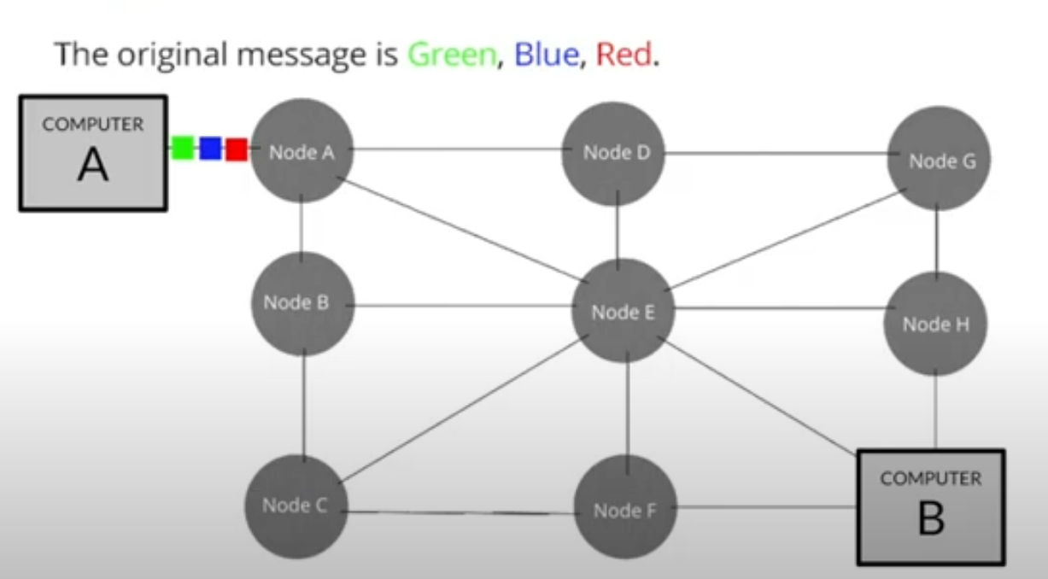
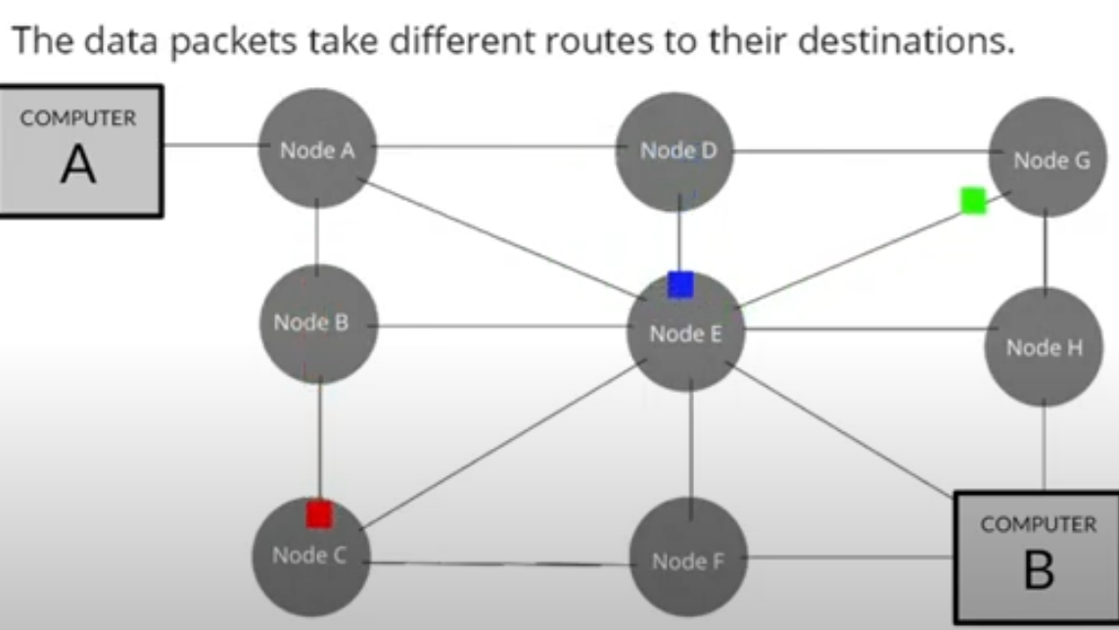
Example of Packet Switching

Slide 11
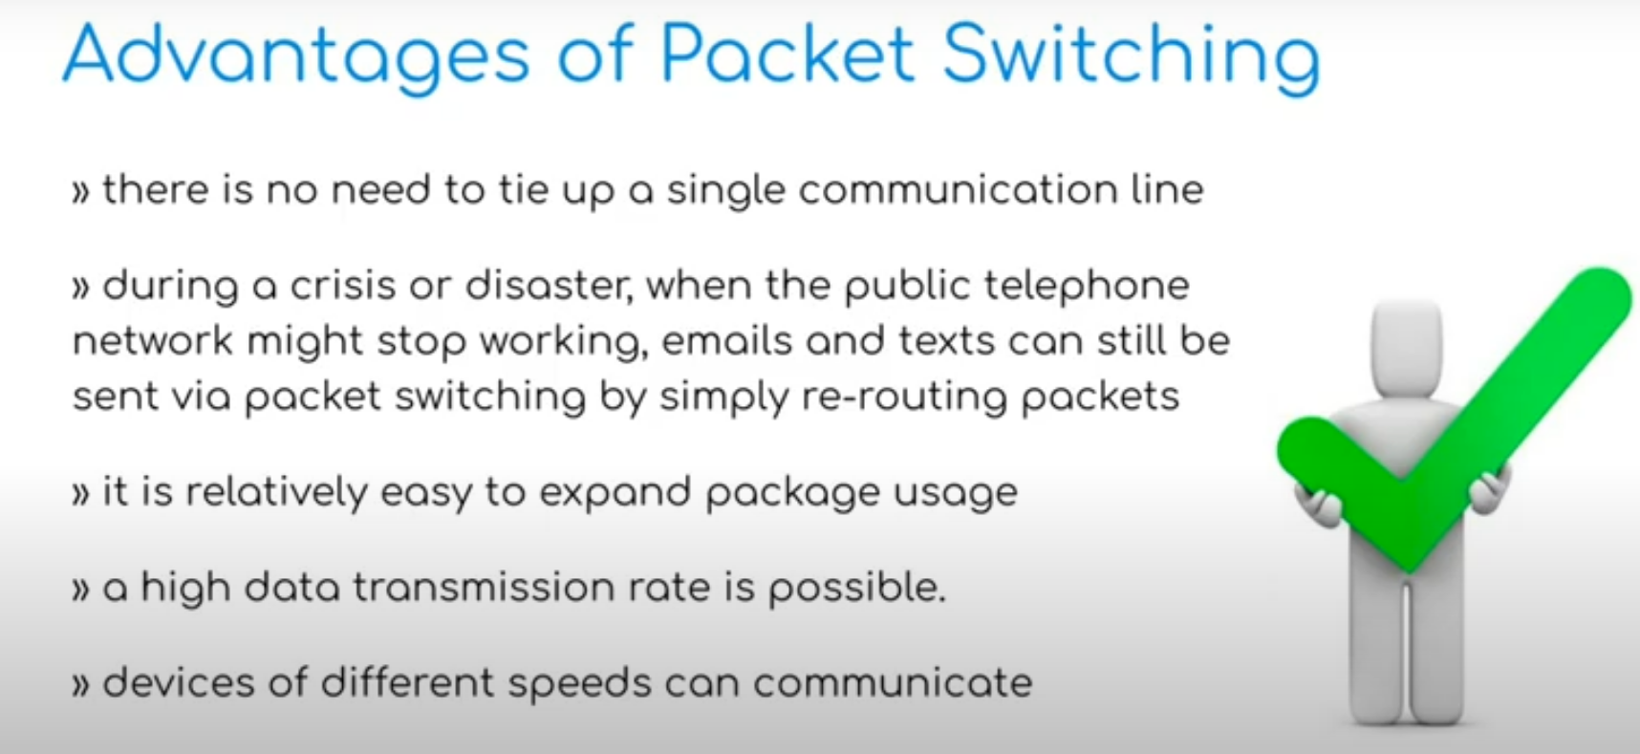

Slide 12
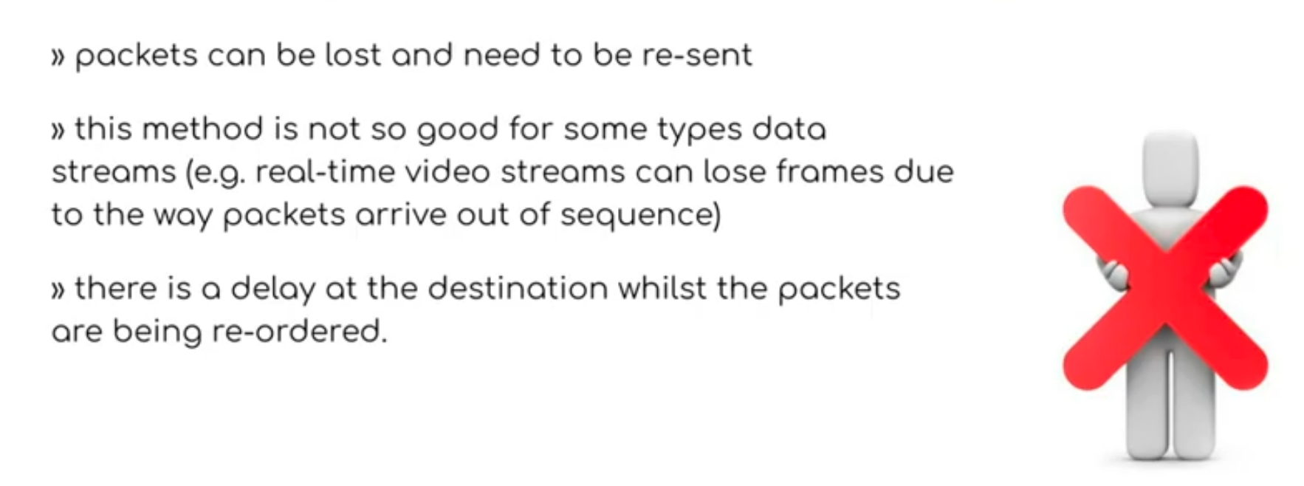
Disadvantages of Packet Switching

Slide 13
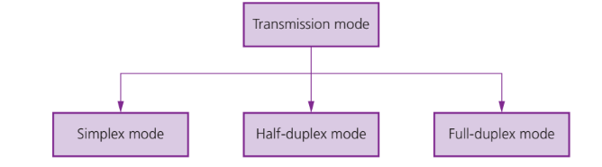
Transmission Modes

Slide 14
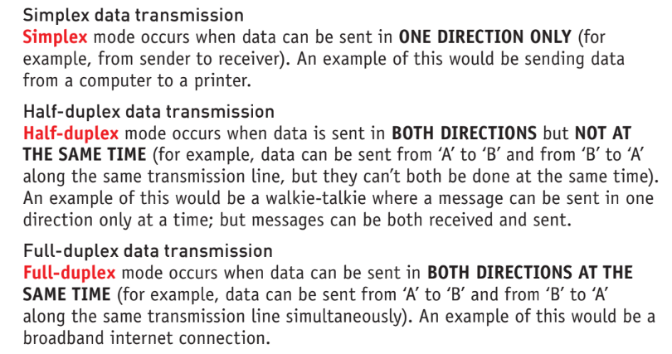

Slide 15
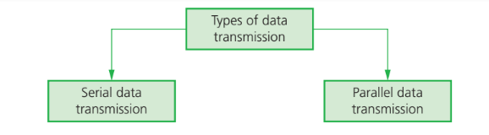
Serial and Parallel Data Transmission

Slide 16
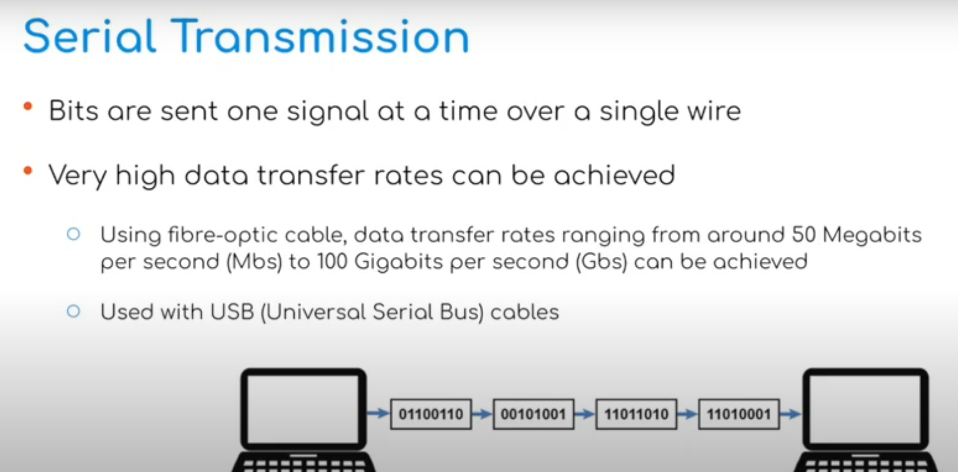
Source: https://www.youtube.com/watch?v=iTVyQMdVkBs

Slide 17
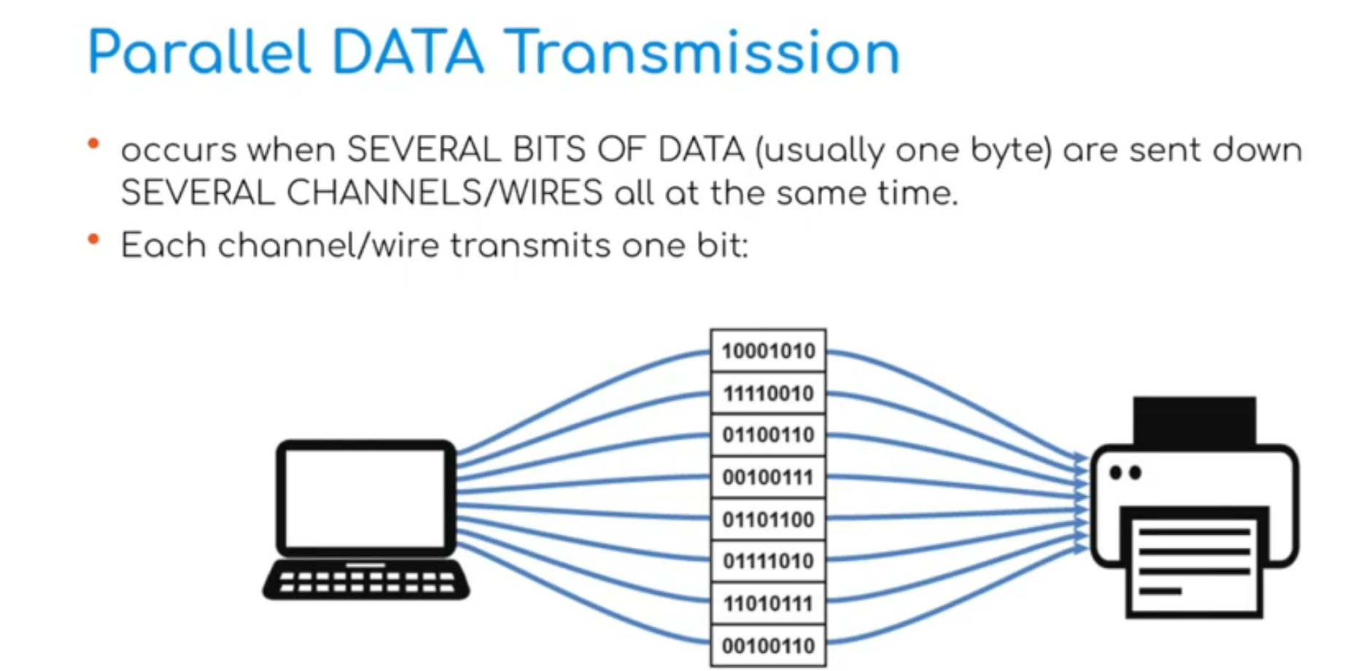

Slide 18
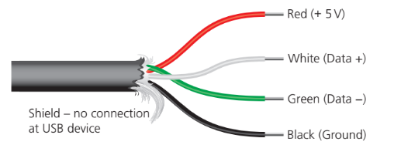
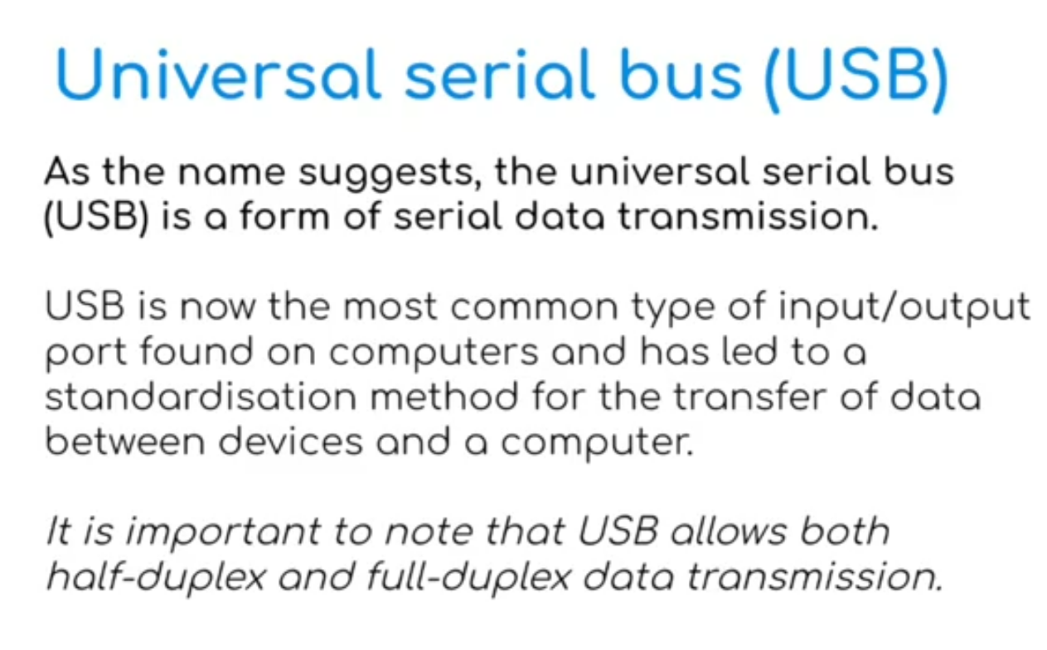

Slide 19
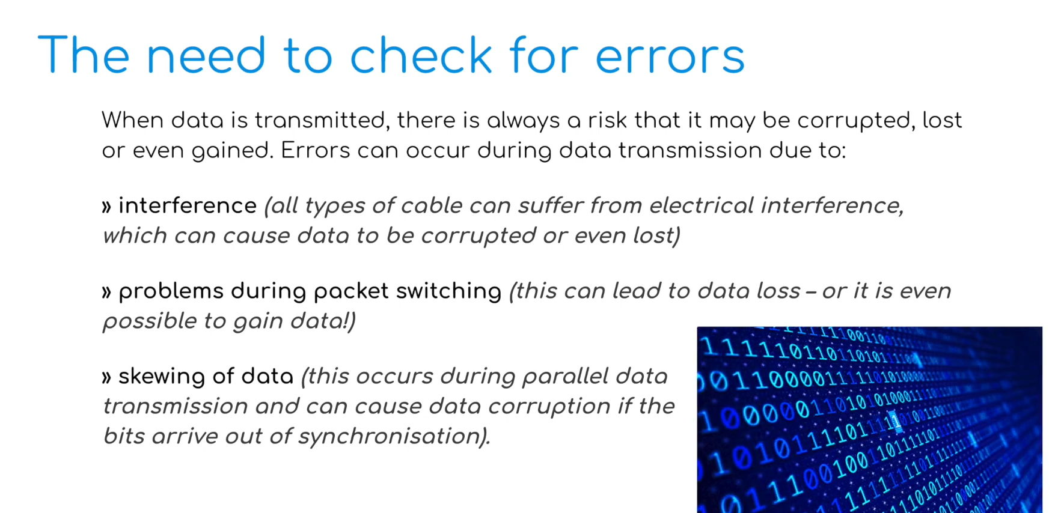
Source: https://www.youtube.com/watch?v=Jco6ANUD6GY

Slide 20
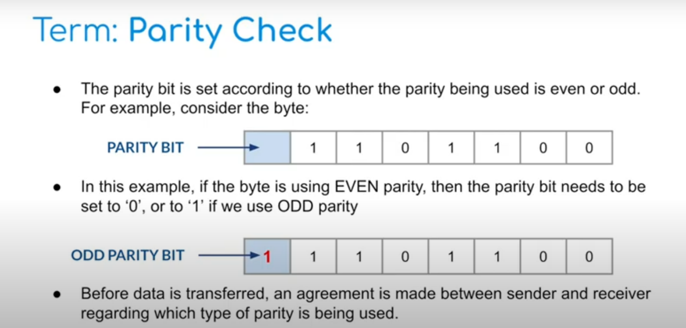
Parity Check
It is a form of error detection where an extra bit (the parity bit) is added to a string of binary code to ensure the number of 1-bits are either even or odd.

Slide 21
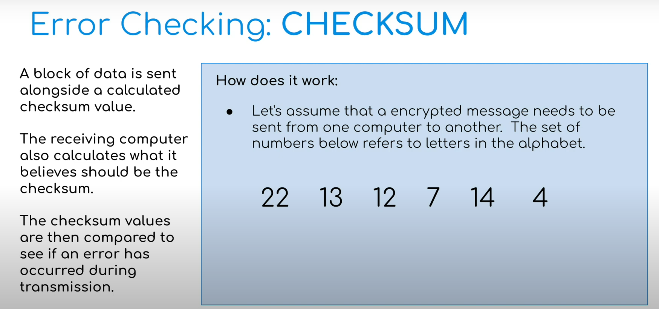
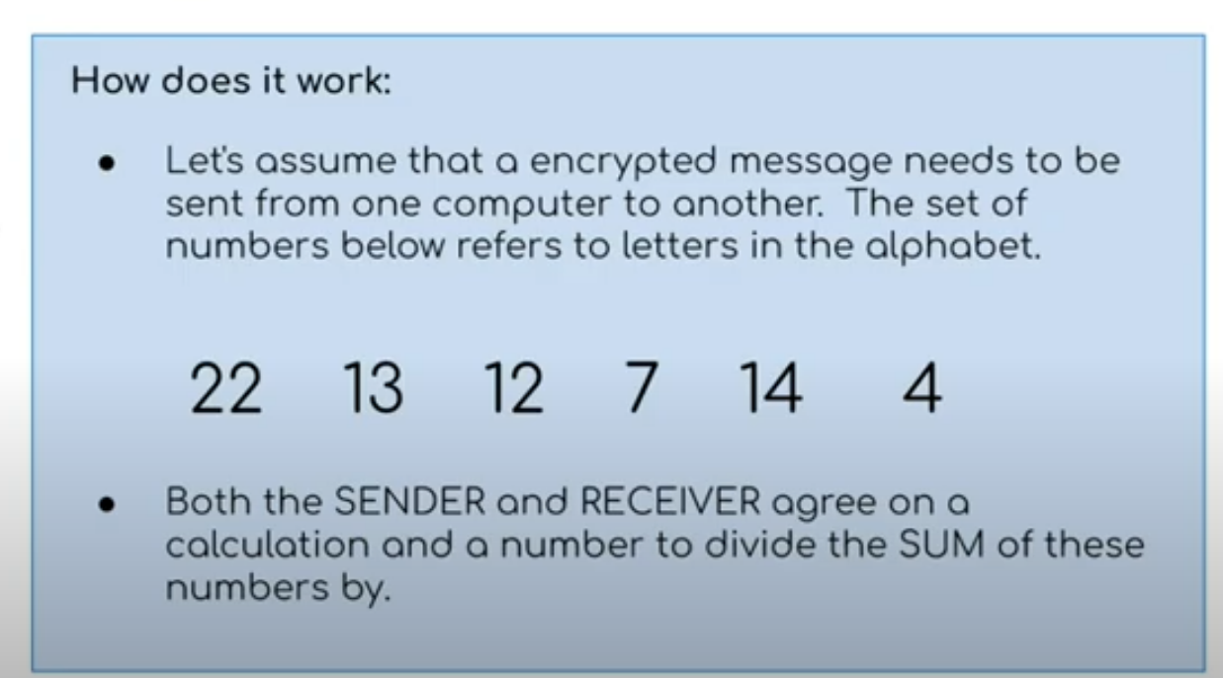

Slide 22
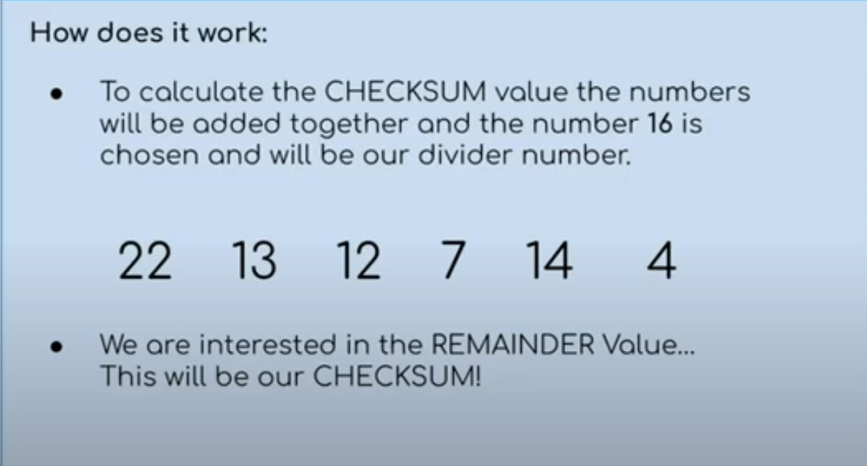

Slide 23
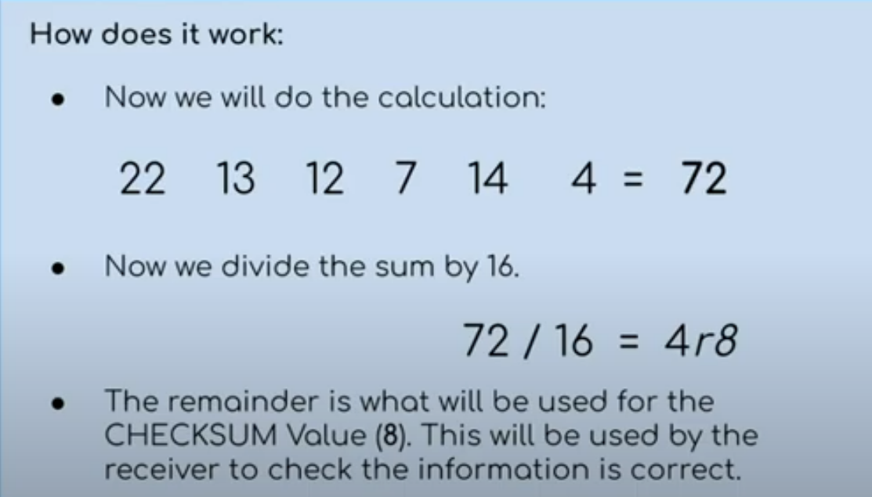

Slide 24
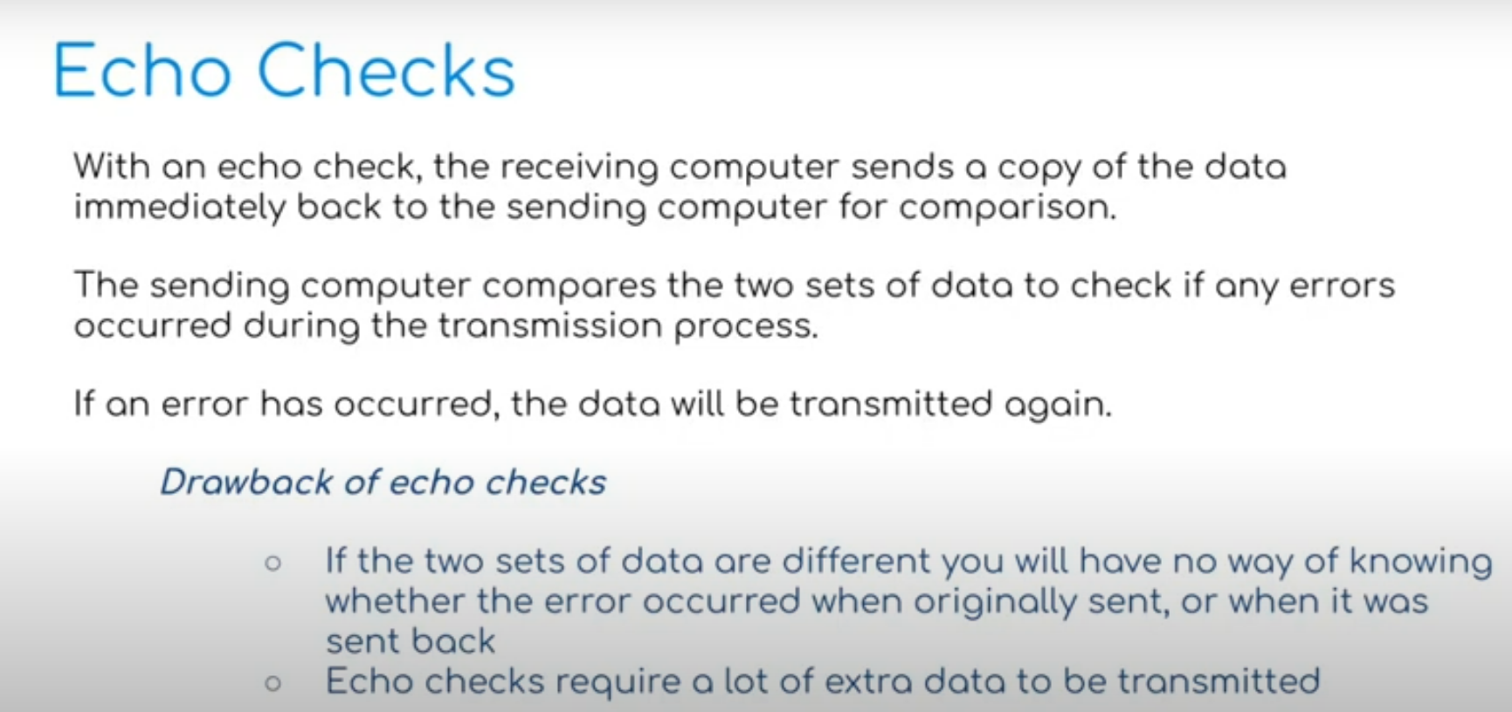

Slide 25
Check Digits
A check digit is the final digit included in a code; it is calculated from all the
other digits in the code. Check digits are used for barcodes on products, such as
International Standard Book Numbers (ISBN) and Vehicle Identification Numbers
(VIN).
Check digits are used to identify errors in data entry caused by mis-typing
or mis-scanning a barcode. They can usually detect the following types of error:
» an incorrect digit entered, for example 5327 entered instead of 5307
» transposition errors where two numbers have changed order, for example 5037
instead of 5307, and so on.

Slide 26
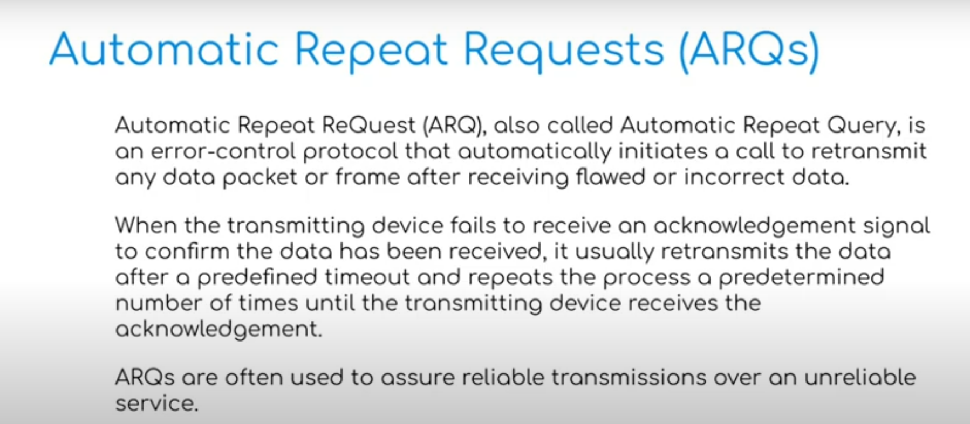

Slide 27
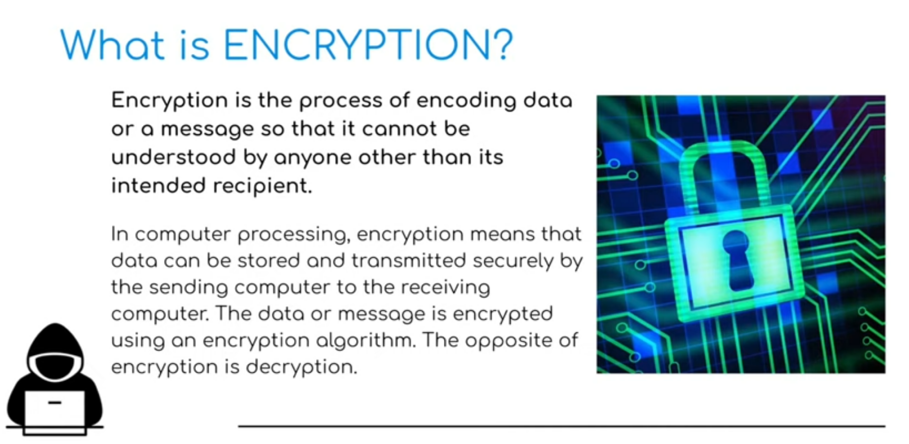
Source: https://www.youtube.com/watch?v=MBCO5hUGBTo

Slide 28
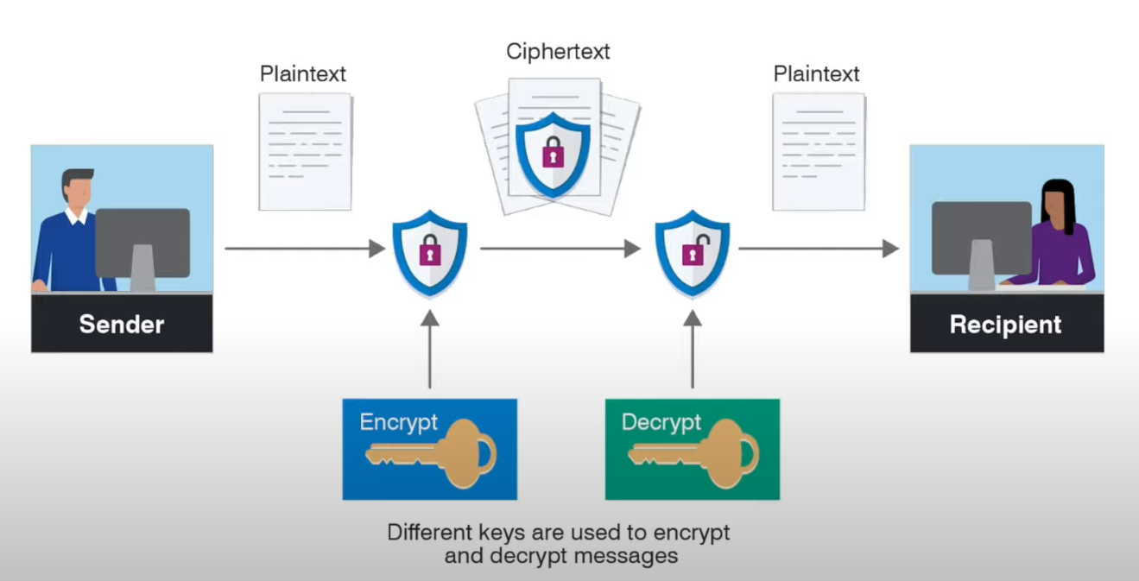
Plaintext and Ciphertext
The original data being sent is known as plaintext. Once it has gone through an encryption algorithm, it produces ciphertext.

Slide 29
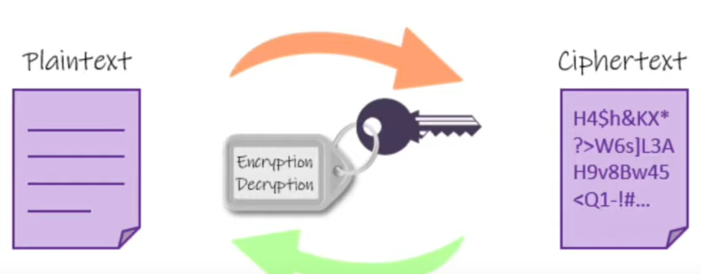
Symmetric Encryption
In Symmetric-Key encryption the message is being encrypted by using a key and the same key is used to decrypt the message which makes it easy to use but less secure.
It also requires a safe method to transfer the key from one party to another. Communicating parties must have the same key in order to achieve secure communication.

Slide 30
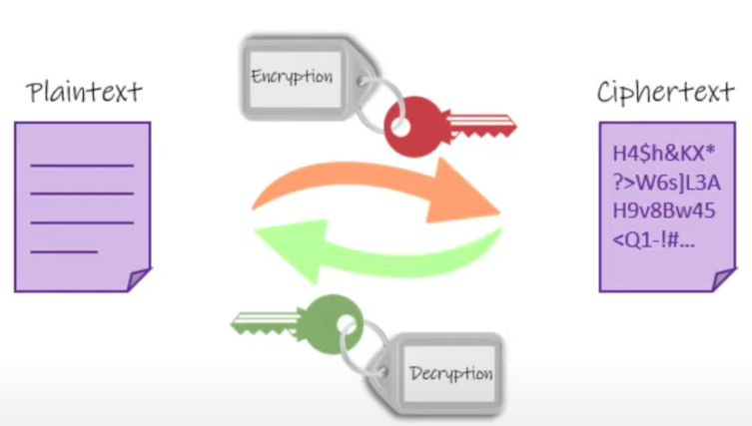
Asymmetric Encryption
With this approach, a pair of linked keys is used and consists of a public key, used to encrypt data and a private key used to decrypt data. Both keys are different but related.
The public key is available to everyone who wishes to send a message. On the other hand, the private key is kept at a secure place by the owner of the public key.

Slide 31
Quiz
https://docs.google.com/forms/d/e/1FAIpQLSdhvjJoYHIeg-2XNNDOLrp9vT00V0zlQchRiYzC5vu-hECNkw/viewform?usp=sf_link

